Slide 1
Preparing for the Job Market: The Application Process (Part II)
Bill Carbonaro, DGS
University of Notre Dame
Department of Sociology
February 2012

Slide 2
The Hiring Process (at most Schools)
Applicant Pool
Invited Applicants
Offered a Position
☹
☹
☹
Apply
Interview
Offer

Slide 3
The Hiring Process
BAD NEWS – for even the most successful candidates, rejection is the NORM
GOOD NEWS – you only need ONE SUCCESS
** Strong candidates simply have more offers to choose from

Slide 4
Planning Ahead
TIMELINE
SUMMER b/w Yrs. 5 and 6 | FALL YR 6 | SPRING YR 6
Start getting ready for the job market: C.V. Cover Letter Teaching Statement Research Statement Prepare Drafts of Dissertation Chapters to send out Recommendation Letters Attend ASA | Start searching for and applying for Jobs: Early through late Fall Waiting to hear: Put together your job talk! Keep working on your dissertation | Keep Applying for JOBS as they appear. Start hunting around for Post-Docs?

Slide 5
Applying for Jobs
CAVEAT #1: A successful job search takes A LOT of time and energy!
Jump in with both feet, but . . .
Don’t forget to keep working on your dissertation so that you graduate on time!

Slide 6
Applying for Jobs
CAVEAT #2: Searching for a job can be VERY discouraging, and you will experience more rejection than success!
STAY POSITIVE!
  Remember – it is VERY COMPETITIVE!
  Fit issues often derail even the best applicants!
  It’s not about you as a person – don’t take it personally!
  Being bitter and negative will NOT help you; it will only hurt you!

Slide 7
The Job Market – How does it look?

Slide 8
Applying: Who’s hiring?
Main Resource: ASA Job Bank
Other resources:
  Job Service at ASA Annual Meetings → Should you go? It depends on the job that you are looking for.
  Other advertised resources (the Chronicle, other discipline specific resources for jobs outside sociology)
  Word of mouth? (Not much action there)

Slide 9
What’s the Outlook?
SHORT TERM
  Getting Better
    Still Fewer Jobs (“The Great Recession”)
    Lots of applicants – very competitive
LONG TERM
  Still Promising
    Education is still a “growth industry”
    Continued investment in research for the next several years

Slide 10


Highlights from ASA
The following slides are borrowed from:
“The Future of Sociology” Presentation by Roberta Spalter-Roth, ASA
“Moving Towards Recovery: Findings from the 2010 Jobs Bank Survey” Spalter-Roth, Scelza, and Jacobs
Available at:
http://www.asanet.org/research/Future_of_Sociology_2011.ppt
http://www.asanet.org/research/Moving_Toward_Change_2010_Job_Bank_Survey.pdf

Slide 11
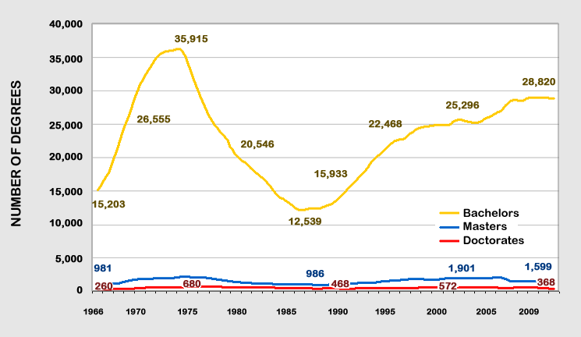
Sociology Degrees Awarded by Degree Level,
1966 – 2009
(number of degrees)
Source: U.S. Department of Education, National Center for Education Statistics (NCES), Integrated Postsecondary Education Data System (IPEDS) Completions,1966-2009 (Washington, DC: NCES, 2010). Retrieved from https://webcaspar.nsf.gov (November 4, 2010).
Slide 4

Slide 12
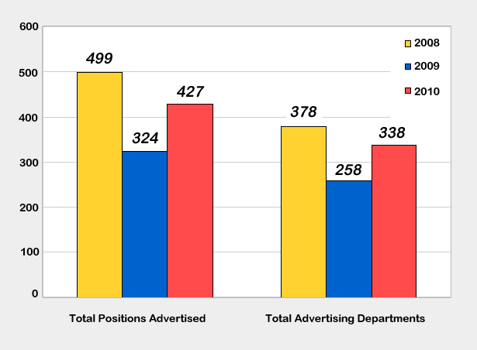
Assistant and Open Rank Faculty Positions Advertised Through the American Sociological Association, 2008 – 2010*
Source: ASA Job Bank Survey, 2010
* Excludes foreign positions and departments.
Slide 8

Slide 13
Overproduction of PhDs in Sociology?
A question with no clear answer
ASA Reports suggest “no”
** Much depends on “market conditions”
  2000, 2009 – Maybe, Yes
  2002-2007 – Maybe, No

Slide 14
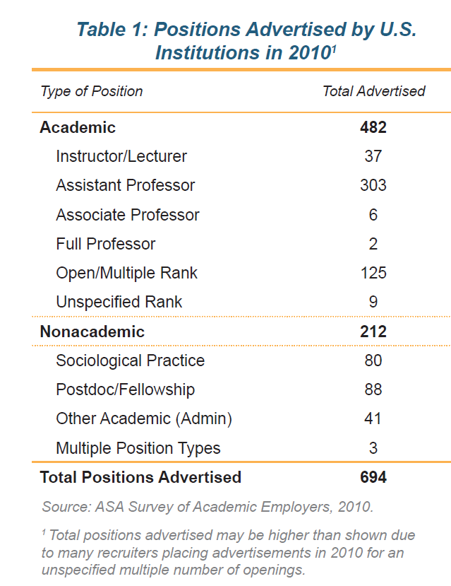
Most jobs are both tenure track positions
Large number of non-academic positions – but many are postdoc positions (terminal)

Slide 15
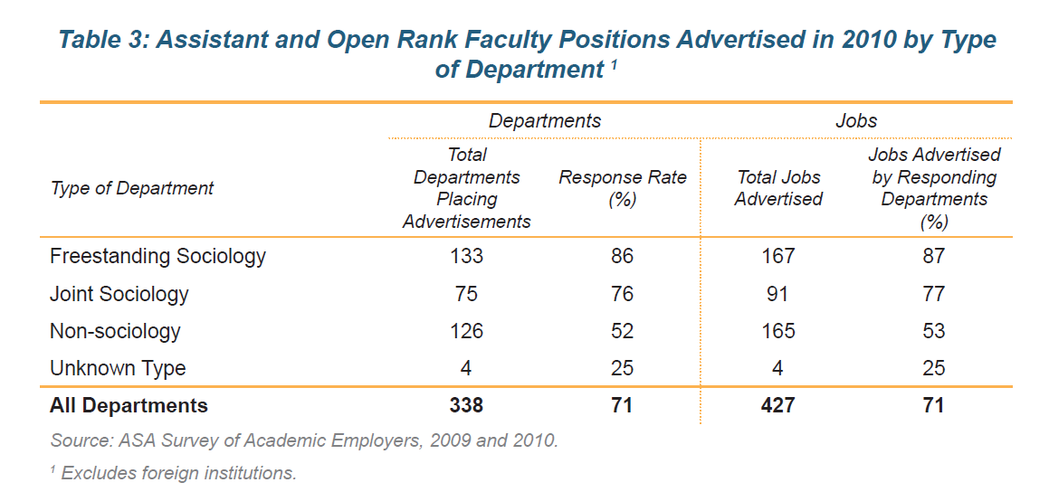
Which Departments are Hiring?
Many non-sociology departments are looking for sociologists!

Slide 16
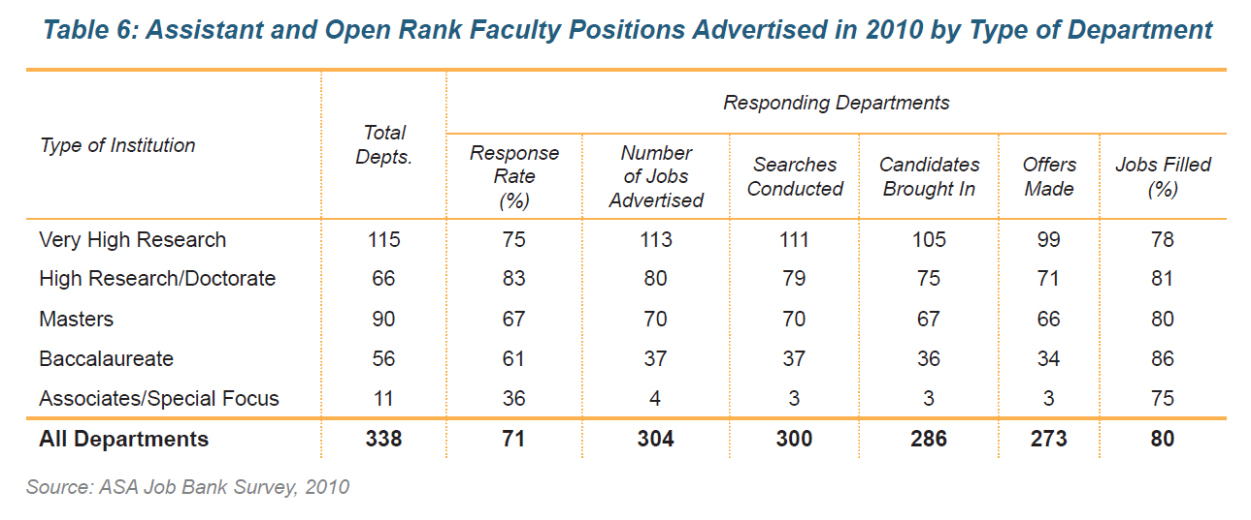
Which Departments are Hiring?

Slide 17
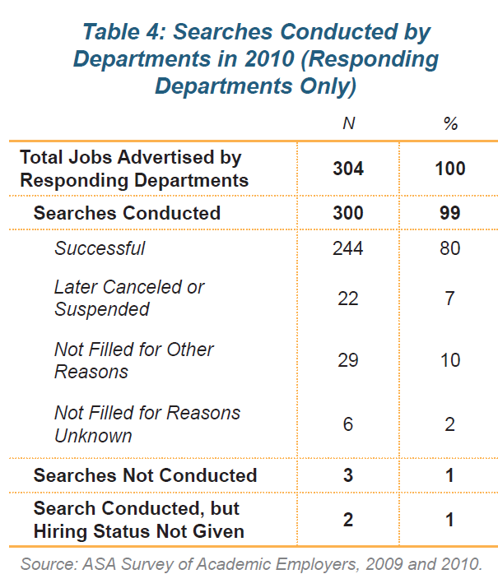
Most searches end with a hiring
Very few searches are “exploratory”

Slide 18
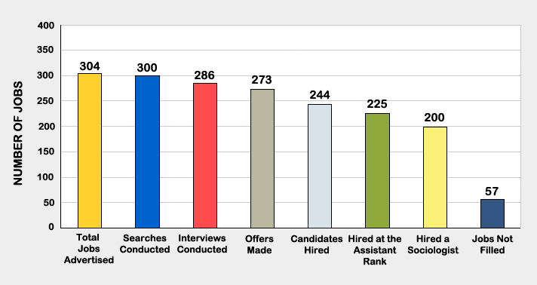
The Hiring Process for Assistant and Open Rank Positions Advertised Through the ASA Job Bank in 2010
(Responding departments only)
Slide 20
Source: ASA Job Bank Survey, 2010

Slide 19
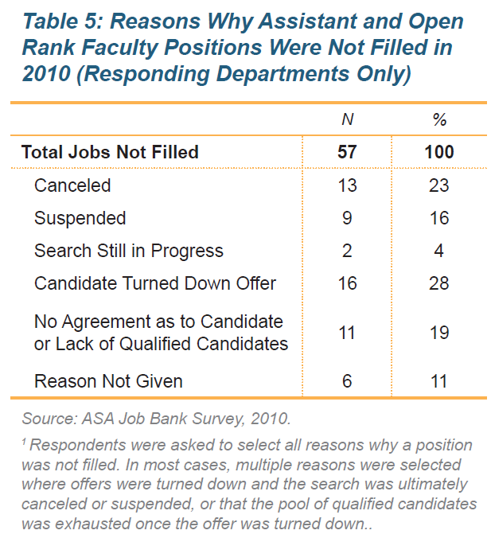
Lots of opportunities out there, if you have the right record and are a good fit.

Slide 20
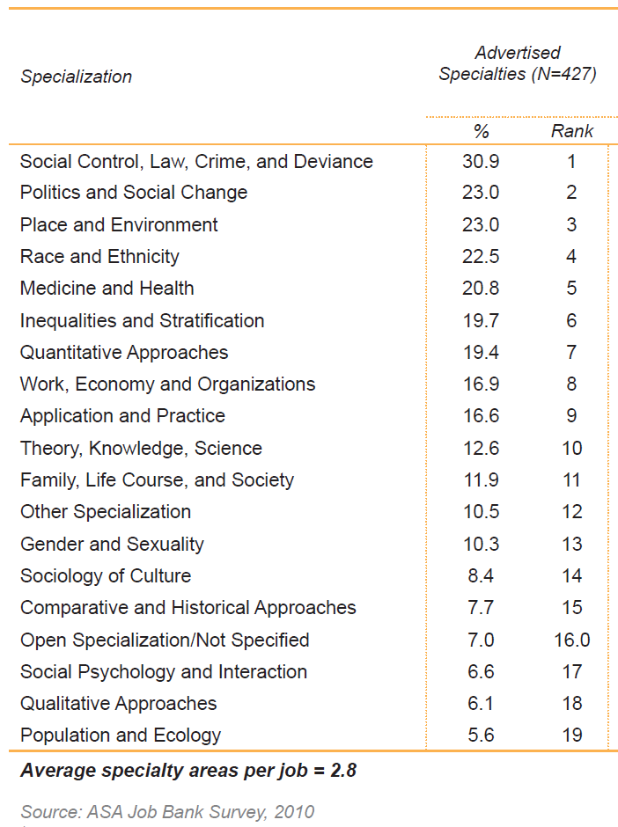
Which Subfields are in Demand?
ND Area Exam Fields*
23.0 + 19.7 + 8.4 + 6.6 + 12.6= 70.3% of advertised jobs
+ 7.0% = 77.3% of advertised jobs
Education** and Religion?
Some small share of 10.5%.
* Not including “Stats and Methods”
** “Education” is actually a bigger share because of the education school/dept market.

Slide 21
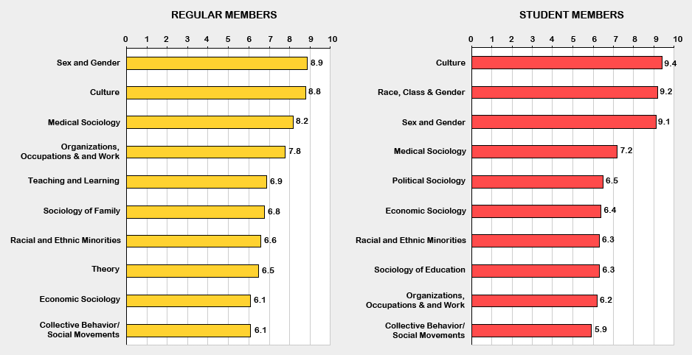
Top 10 Sections in 2010, by Membership Status
(rank and percent of group)
Slide 29
Source: ASA Membership Database

Slide 22
Comparison of Specializations Listed in All Assistant and Open Rank Job Bank Advertisements in 2010 to Areas of Interest Selected by PhD Candidates on ASA Membership Forms in 2010
Specialization | Advertised Specialties (N=427) |  | Areas of Student Interest in 2010 (N=4,511) |  | Difference in % of Specialties Compared to Interest *
 | % | Rank | % | Rank | %
Sociology of Culture | 8.4 | 14 | 24.3 | 3 | - 15.8
Inequalities and Stratification | 19.7 | 6 | 34.7 | 1 | - 15.0
Social Control, Law, Crime, and Deviance | 30.9 | 1 | 17.9 | 7 | + 13.0
Politics and Social Change | 23.0 | 2 | 33.9 | 2 | - 10.9
Place and Environment | 23.0 | 3 | 13.7 | 10 | + 9.3
Gender and Sexuality | 10.3 | 13 | 19.6 | 5 | - 9.3
Sources: ASA Job Bank and Membership databases.
* A minus sign indicates an oversupply of graduate students. A plus sign indicates an undersupply.
Slide 21

Slide 23
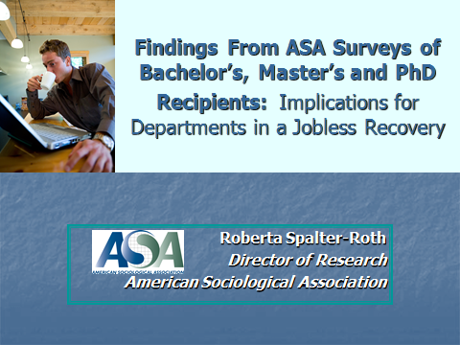
Non-Academic Jobs
http://www.asanet.org/images/research/docs/ppt/ImplicationsforDepartments2011.ppt

Slide 24
The largest group (36%) of PhD sociologists are in applied, research, and policy positions in the private, not for profit sector and another 32% are working in the government sector.

Slide 25
Applied and public sociology PhD sociologists work on a wide variety of topics, with close to 1/3 working on health issues.

Slide 26
Navigating the Search and Application Processes

Slide 27
Applying: Reading the Ad
Go look at some ads . . .
Helpful Advice: Start looking at these ads LONG BEFORE you hit the job market!
  Get a sense of the job market looks like
  Get a sense of what kinds of things you will need to have to compete for certain jobs

Slide 28
Which Jobs should you Apply for?
“Cast a wide net.”– Adam Gamoran
What criteria should use?
  FIT:
    Between your record/skills and the job
        Each of you will be underqualified for some positions, and overqualified for others
    Between your substantive area and the job/dept.
        Stretching is OK – but be realistic

Slide 29
Which Jobs should you Apply for?
“Cast a wide net”
What criteria should you use?
  PERSONAL:
    Where do you want to live, work, etc.?
    How much money do want to make?
    (FILL IN THE BLANK)
CAVEAT: You can elect to be picky, but recognize that this comes at a price (more limited searches are less likely to be successful)

Slide 30
Applying for Jobs You’re Not “Wild” About
SOCIAL PROOF at work!
Getting interviews and offers allow you to contact other departments and “check in” and “see where they are” in their search.
  Departments see your success on the market as SOCIAL PROOF that you are a strong candidate!
GOAL → To set a VIRTOUS CYCLE into motion
    “Offers beget offers.”

Slide 31
Applying for Jobs You’re Not “Wild” About
Have an OPEN MIND
The department may be better (or worse!) than it appears at first glance.
It’s hard to know whether you can live someplace without visiting!

Slide 32
Applying: Reading the Ad
Avoid calling or e-mailing, unless it is really important!
Follow the instructions.
If you are unsure, err on the side of applying rather than not applying.

Slide 33
Your CV
Review your notes from Prosem!
Get advice from your advisor.
What’s on there matters more than the format; but make sure the format helps you put your best foot forward.
Don’t bother with CV “padding” – there is no point!

Slide 34
The Cover letter
  Generally, the first thing that people will read (after your CV).
What is it for?
  To tell the chair and search committee WHO you are, describe your strengths, and explain what you will do if you are hired.
  This is your opportunity to MAKE YOUR CASE!

Slide 35
The Cover letter
CONTENT
  SUBSTANTIVE AREA
    Delineate your professional identity as a scholar (Area, theory, methods) → who are you?
  RESEARCH
    Talk about your research accomplishments
    Talk about your future research agenda
  TEACHING
    Talk about your teaching accomplishments
    Talk about what your future plans for teaching
  FIT
    Emphasize places where the fit is really good
    Explain why you think you’re the best person for the job

Slide 36
The Cover Letter
LENGTH
  As long as it needs to be. Two single spaced pages is not unusual. But, don’t go overboard – people won’t read it if it is too long.
OVERLAP
  Don’t just repeat what’s in your research and teaching statements.

Slide 37
The Cover letter
Spend A LOT of time perfecting this! Get feedback from your advisor.
Incorporate both “boilerplate,” and “customized” sections so that each letter that you send out is unique to a given dept.

Slide 38
The Cover Letter
Special Considerations: Is there something unique about your profile, which needs further elaboration/explanation?
  The cover letter is the place to address these issues.
    Eight years to finish grad school → Serious illness that caused me to take a year off from graduate school
    One bad semester? → Went through a messy divorce
    CAVEAT: Don’t get carried away here; stick to major issues w/ LEGITIMATE explanations!

Slide 39
The Cover Letter
  OTHER TIPS
  AVOID talking about why you went into sociology or how influential your first reading the Sociological Imagination was! This is a not your “personal statement” to grad school.
  Always be professional in tone.

Slide 40
Research Statement
Only provide if they ask for one; otherwise this goes in your cover letter.
What are you “about” as a researcher?
    Connect the dots! What’s the big picture?
    Describe how your research (so far) fits together THEMATICALLY.
    Map out your research agenda for the future, and show how it connects to your prior/current research.
    Talk about theory and methods, not just findings.

Slide 41
Teaching Statement
What are you “about” as a teacher?
    What is your overriding philosophy about teaching?
    What do you hope to accomplish in the classroom?
    How have you (or how do you plan to) done this?
    Use examples from your teaching to drive your points home.
    What courses might you teach in the future? What courses COULD you teach?

Slide 42
Letters of Recommendation
What are they for?
  Decreasing Uncertainty in an Inherently Uncertain Market
Do they actually matter?
  Really good ones help
  Really bad one hurt
    Most lie somewhere in between
    May make a difference, but only at the margins

Slide 43
Letters of Recommendation
Who should you choose?
  Your advisor (a must)
  Professors who know your work
    Who know your research, know your teaching, etc.
  “Big Names” in the field
  People with credibility, who are active in the fields, whose judgment is credible to others
  Ideally, pick faculty who fall into more than one of the above categories!

Slide 44
Letters of Recommendation
How do you know who will write you a good letter?
  Give your letters writers an opportunity to say no
    If they say “no,” their letter would probably not have helped you much (too busy, not motivated)
    If they still say “yes,” then they will be more committed to writing a good letter for
  Ask your advisor for input about who you should pick → they should do some “behind the scenes” work for you

Slide 45
Letters of Recommendation
How do you get someone to write you a rally good letter?
  Explain to each letter writer the reason WHY you picked him/her
    What do you hope that person’s letter will accomplish?
  Talk with them about your goals for the job search
    This ensures a good fit between the letter and what the committee wants to know
  Talk with them about how you are going to “market” yourself as a candidate
    Think reinforcement, not redundancy
  Make sure that the letter writer has all of the necessary information
    CV, publications, papers, etc.

