Slide 1
Tips for First Time Teachers
Bill Carbonaro
Department of Sociology
April 2010

Slide 2
Tip One: Goal Setting
Before you do anything else, answer this question:
What are you “about” in the classroom?
Notes:
What are you trying to accomplish in the classroom? What do you want your students to do be able to do when they leave your class?
Most people go out, start teaching, and then after they have taught several classes, and have to find a job or get promoted for tenure decide to write a teaching statement. This is backwards – figure out what you are about in the classroom, FIRST, then use that self-definition to guide your practice in the classroom.
Ex – in my class, I want my students to learn to critical thinking skills. More specifically, I want to teach them how to think differently about the course content. You can, of course, be about something else: I want my students to be inspired to change the world; I want my students to engage in self-discovery; I want my students to have mastery of specific content.
Here is the opening of my teaching statement:
Every class that I teach at Notre Dame has two main objectives: (1) to change what students know about a topic and (2) to change how students think about that topic. The importance of the first objective is self-evident, but the second goal requires some explanation and justification. First, students retain only a small portion of what they learn in any course. If I can change how my students think about education and inequality, I will have a more enduring impact on them. Second, critical thinking actually helps students master more content in my courses. Students retain important knowledge about education and inequality when they incorporate that knowledge into their thinking about the social world. Third, my focus on thinking encourages my students to be more intellectually independent and more active participants in the learning process. Fourth, critical thinking is a valuable skill that students can usefully apply to all of their classes at Notre Dame, as well as their personal lives and future professional careers. Finally, a focus on critical thinking explicitly encourages students to be open to different viewpoints and exhibit a willingness to re-examine their own beliefs about the world.
Give yourself a label – I am “Mr. CT.” We all know (as sociologists) that labels provides us with scripts to follow. If I am Mr. CT, then all I need to think about when I’m designing my course is, “what’s on my script?” When I face a situation when I’m unsure about what to do, I go back to the script to answer that question.

Slide 3
Tip Two: Set your Target
Notes:
Make sure that students have a clear understanding of what you are about in the classroom. Come back to this point again and again. It is important to shape their expectations so that they understand what you are trying to accomplish. Make sure that students can see that they are meeting the goals that you have set for them.
Once they know what you are “about” as a teacher, you have to set a good target for students to “shoot” for. I want my students to be critical thinkers, but they will struggle in that journey if I don’t give them a clear idea as to what “critical thinking” is. If I don’t give students a good target to shoot for, how do I ever expect them to meet the goals that I set for them?
I have a script to follow, but they need one too. Remember – they ALREADY have a script to follow. If you want your students to behave differently that they do in the “typical” college class, you need to make them aware that the “old” script won’t work in your class.
Critical thinking entails the following elements:
Defining KEY TERMS
Identifying CORE ASSUMPTIONS
Examining the EVIDENCE
This is what I want my students to do. If they demonstrate proficiency in these three areas, then they should do well in my class. If they don’t, then they should do poorly. They have a clear path to success b/c they understand what I want from them.
Make sure that students can see that they are meeting your goals. Create RUBRICS that lay out exactly what you are looking for when grading assignments.

Slide 4
Tip Three: Alignment
Notes:
Align your reading assignments, pedagogy, exams, writing assignments, grading rubrics, etc. so that they all point in the same direction → towards whatever GOAL you have set as a teacher. Think of what you are “about” in the classroom as the force (like this magnet) that pulls everything together and points everything in the same direction.
EX--
If I am “about” changing how my students THINK about the material, I had better be sure everything that my students do in my class pushes them towards that objective. When I grade their exams and writing assignments, I had better reward students who show they can think critically about the material. Likewise, I had better show students that they will do poorly in my class if they don’t demonstrate these skills in their work.
Example One – First assignment: tell me what you think about _(fill in the blank) . Final assignment: revisit the first paper and tell me how your thinking has changed.
Example Two – In class writing assignments → provides an opportunity for students to think critically.
Example Three – Short essay assignments → they require that students think critically. Feedback on those point.

Slide 5
Tip Four: Practice
Aglet
Notes:
We grossly underestimate the amount of time that students need to develop mastery of content and concepts. Why? The “curse of knowledge.” Tappers and listeners. Tappers were asked to predict how likely the listeners would recognize the “tapped” song. They guessed that their chances of getting the right song were 50%. It was actually 2.5% (3 out of 120). It’s hard to know what other people’s minds are like when we already know something.
“Chunking” principle of learning. Working memory – site of awareness and thinking. Long-term memory – factual and procedural knowledge. Working memory is largely fixed. But we conserve space by recalling information in “chunks.”
Ex – aglet. We have each conserved space by the letters into a specific word. We can pronounce it, but most of don’t have a meaning attached to it. The sentence “I lost an aglet walking to school today” doesn’t make sense to us.

Slide 6
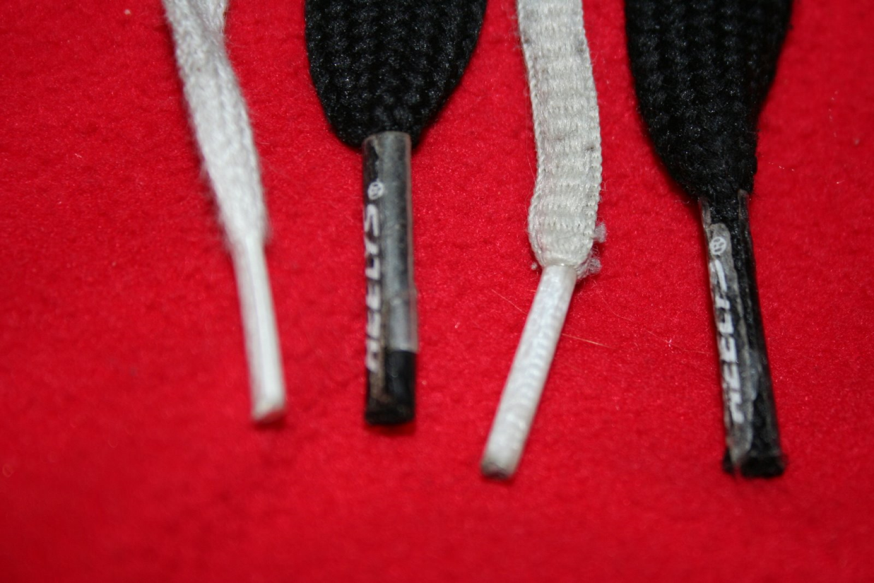
Tip Four: Practice
Aglet
Notes:
Now – we can associate a meaning with an aglet, and we can chunk that too so that when we “aglet” we have a mental picture that goes with it. The sentence “I lost an aglet on the way to school today” is much more useful to us now, and we can learn more from it.
Now – the problem is that I could give most of you a vocabulary test in six months, and I put aglet on there with a bunch of other challenging words, most of you would not get this item correct. That’s because you have not had sufficient practice to make aglet stick in your memory.
That’s a big problem that we face – our students need much more practice at learning new material (facts, ideas, concepts) than we think.

Slide 7
Tip Four: Practice
Institutions
Notes:
Here is an example of an important sociological concept that we want students to learn. There are many others: culture, role, norm, anomie, loose coupling, authority. Despite the fact that the word “institution” is already in people’s heads, most students would struggle to define what this word means. There is no easy image to post that tells instantly what this means. It’s much, much harder to chunk a concept like “institutions” than aglet, and students need much, much more practice than we think to master such a concept.
WHY? KEY POINT – we are like the tappers!! As experts, we retrieve this concept effortlessly in a chunk that allows us to save space in our working memory for other information that we can manipulate and learn new things. As novices, students need lots of practice to get to the stage where they are comfortable with this concept.
Use lots of different examples with the same concept, and ask them to apply this ideas to many, many different problems.

Slide 8
NORMATIVE FRAMES:
LABAREE:
Democratic Equality
Social Efficiency
Social Mobility
Meritocracy :
Good and Bad Inequality
TOOLBOX FOR SOCIOLOGY 20228
PEERS AND INEQUALITY
Peers increase in importance during adolescence, while families decrease in importance
Group Contrast Theory (Differentiation and Assimilation)
Social Identity Theory
Close Friends/The Clique/The Crowd
Adolescent Society – students are oriented towards their peers; most peers gain status popularity via non-academic pursuits
Prevailing Norm → “Getting by without showing off”
“Crowds” -- Socially Elite (20%); Alienated (20%); Average (“Normals”) (30%); Ethnic-Race (10-15%); “Brains” (< 5%)
LAUNCH/TERRITORIES/
NAVIGATION
Families effects are INDIRECT → they select the peer environment (e.g., schools, neighborhoods, clubs/extracurriculars)
BETWEEN SCHOOL INEQUALITY
Coleman Report:
Most variation (20-30%) in achievement levels and gains is within (not between) schools
Schools are more similar than they are different
Teacher quality and composition are school characteristics most closely related to achievement
Student’s demographic characteristics and attitudes are stronger predictors of achievement than school characteristics
Only about 30-40% of the race and SES gaps in achievement are between schools
Substantially more of the POVERTY gap is between schools (50-60%)
Lankford Curve: Better teachers are sorted into schools with more advantaged students
Achievement gaps are already present when children begin school; the gaps grow bigger over time as student progress through school
Money matters – but it’s not a straightforward relationship
MODEL OF STUDENT LEARNING
Effort
Opportunity to Learn
Ability
Additive vs. Multiplicative Models
CUMULATIVE ADVANTAGE
RACE-ETHNIC INEQUALITY
R-E differences emerge as early as 24 months, and they grow bigger as children enter and progress through school
Big B-W differences in SES, but these only account for 1/3 of the B-W gap
Summer learning trend is OPPOSITE of SES → Equal B-W learning in summer, B-W gap gets bigger during the school year
Genetic differences? → NO
Test Bias? → NO
R-E differences in parenting styles (net of SES)
R-E differences in parent involvement
R-E differences in attributional styles – “High cost of Americanization”
R-E differences in beliefs about consequences of SCHOOL FAILURE
R-E differences in peer groups
Black students report doing less homework and are rated by teachers as hard-working
Oppositional Culture → Voluntary vs. Involuntary Minorities; “Acting white”
The Attitude/Achievement Paradox: Concrete vs. Abstract Attitudes about schooling
Cultural Capital vs. R-E differences in Cognitive Culture
Cultural legacies matter
Stereotype Threat →
GENETIC ENDOWMENTS
Heritability vs. Environment
Heritable ≠ Immutable
Nature turns on Nurture – genes trigger environmental influences
Shared vs. non-shared environment
Epigentics – gene expression
Effects of Schooling
The Flynn Effect
WITHIN SCHOOL INEQUALITY
Ability Grouping/Tracking
Course Taking
RATIONALE – “Goldilocks Zone” for each student
U.S. – grouping within schools; Germany and Japan – grouping b/w schools
SORTING Processes
MOBILITY across groups, tracks, courses
EFFECTS on OTL (Instruction, curriculum, teacher quality, class climate)
EFFECT on ACHIEVEMENT
Higher Ability students learn more in tracked classes; low achievers learn less
FAMILIES AND INEQUALITY
Differences in Neonatal Care
NO SES gap at NINE months
SES gap emerge by 2 years after birth
SES gap in achievement grow larger as children progress through K-12
Pre-K – Differences in “Cognitive Culture” b/w families (Number of words, kinds of verbal interactions,
Differences in Childcare/Pre-K programs (Quantity of Schooling and Quality of programming)
Seasonal Learning – More SES divergence in the summer than during the school year
Faucet Theory
“Psychological Capital”
Teacher-quality and class-size interaction with SES – these factors are more important for LOW SES students’ achievement
Concerted Cultivation vs. Accomplishment of Natural Growth
Four R’s of Parent Involvement: Reinforcing, Responding, Reading, Respecting
Authoritative, Authoritarian, and Permissive Parenting Styles (Acceptance, Firmness, and Autonomy)
Authoritative Parenting – fosters (1) greater independence and self-discipline and (2) healthy attributional style (hard work accounts for school success)
Development of PRACTICAL INTELLIGENCE (more important than IQ)
Notes:
Here are the concept and “chunks” of information that I want students in my class to focus on. If students can master this (which doesn’t seem like much), they can begin to think about schooling and inequality in a different way.
But – it takes a long time for them to upload this into their head. They need LOTS of practice at recalling this information, before they can start using it chunks. My job is to (a) highlights which chunks they need to focus on, and (b) ensure that they have sufficient practice to start chunking this information so they accelerate their learning during the course of the semester. The toolbox accomplishes (a), and in-class assignment and essays accomplish (b).

Slide 9
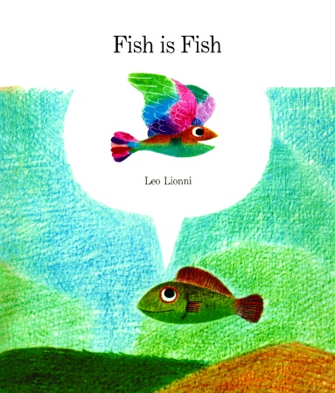
Tip Five: Framing
Notes:
It is important to recognize that people see the world in terms of “frames.” These frames are implanted through prior experience, and they pose a barrier to teaching people about the social world.
Ex – Fish is fish. This fish has never been outside of the water, but his friend the tadpole has come back to tell him about what’s out there. He tells his fish-friend about birds, and this is what the fish imagines. His pre-existing frame about the world shapes how he receives and makes sense of new information.
What pre-existing frames do your students bring with them to your class? How does it affect how they learn material that you teach? You need to make your students (and yourself!) aware of these pre-existing frames and sensitize your student to how these frames affect their thinking.
Ex – How do students learn? Fixed ability frame; opportunity/environment frame; effort frame. My job is to expose students to these frames and help them acquire a new theory that replaces it.

Slide 10
Tip Six: Zone of Proximal Development
Notes:
For learning to occur, students must be engaged in the learning process. Students become engaged with the learning process when they have the RIGHT level of challenge. In educational psychology, this means that we are in a student’s “zone of proximal development.”
Ex – think about the NY Times crossword puzzle. With each day of the week (starting with Monday), the puzzle grows a little harder. Saturday’s puzzle is the most difficult level, and only true experts can get more than half the puzzle; a novice would typically get no correct answers! (Sunday’s puzzle is about a Thursday-level of difficulty.) I find Monday and Tuesday’s puzzle too easy, and it is a little boring to do them. Weds, Thurs, and Friday (as well as Sunday) are fun because they are challenging and require mental effort, but are not impossible. Saturday’s puzzle is too hard, and I will look at it to see whether I can get even one or two correct answers.
You want your students to be in their ZPD. If the work you give them is too easy, they will quickly be bored. If it is too hard, they will be frustrated and give up. KEY PT. – (1) it is very difficult to judge what the appropriate level of challenge is in a sociology class. Typically, there is too much variation, with many tasks that are too easy or too hard. (2) Students within your class will each have their own ZPD, based on their cognitive ability and background knowledge of the subject. This is less of challenge in a school like Notre Dame, but is more serious in a place like U-Wisconsin.
General principal – try to structure your course so that it is consistently increases in difficulty as the semester progresses.

Slide 11
Tip Seven: Make it Stick

Slide 12
Tip Seven: Make it Stick
http://heathbrothers.com/downloads/SuccessModel.pdf

Slide 13
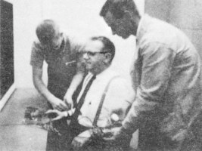
Tip Seven-A: The Unexpected
Notes:
Violate a schema – defy people’s expectations.
Milgram’s experiment was interesting because the results were so unexpected. It is important to note that he asked people (experts, students, adults) what they thought would happen. Everyone grossly underestimated the amount of obedience that was observed. Milgram didn’t have to do this, but it made his results more interesting!
(Note: use this technique to work against hindsight bias [“I knew it along. It was so obvious.”] )
2. People are naturally curious, and you need to use that to your advantage.
Create a mystery – in Citizen Kane, the whole movie is about unraveling what Kane’s dying words (“Rosebud”) meant, and what role it played in understanding his life. The movie would be much, MUCH less compelling and interesting if we learned what Rosebud was in the first few moments of the film. Maintain the suspense as best you can. Emphasize people’s gaps in knowledge.
Ex – how much variation in achievement is found between and within schools? Students underestimate the amount of within school variation. Why? That’s an interesting question that students want to know the answer to!

Slide 14
Tip Seven-B: Be Concrete
Notes:
Students are novices, and they are most able to learn new thing quickly when the material is CONCRETE rather than abstract. Why? Because they use something that they already know to help learn something that is unfamiliar. “What does (fill in the blank) taste like?” “It’s sort of like chicken.”
KEY POINT – as experts, we think abstractly because we are so familiar and comfortable with what we know. “Curse of Knowledge.”
EX – The Class Structure of a society is like the rooms in a house. Each room is like a class category. Are some rooms bigger than others? Are some nicer? In what ways are they nicer? Do all rooms tend have the same amenities (electricity, plumbing, heat)? What determines who gets in which room? Do some rooms have doors with keys, while others have revolving doors? How do you get the key? Who else is in each room? Etc. Students can use something concrete that they know (a house) to learn about something that is pretty abstract (social class). We can compare and contrast the ways in which a house is similar and different than the social class system. Where does the analogy work, and where does it fail?

Slide 15
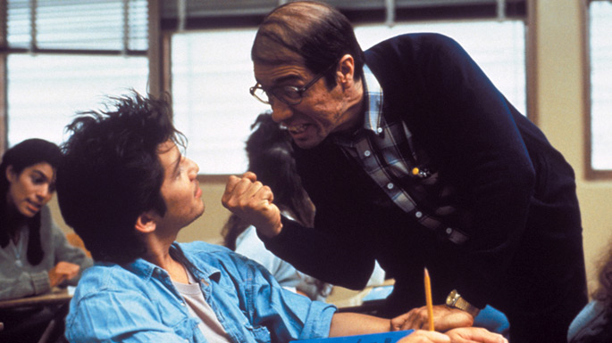
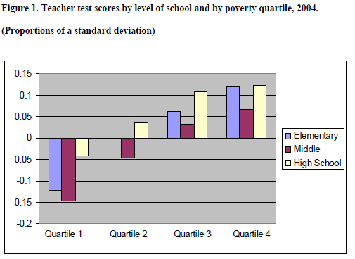
Tip Seven-C: Use Stories
Notes:
Students love stories! Storytelling is an essential component of our humanity. Too often we (as sociologists) dismiss this impulse and try to work against it in our classes. To us, “anecdotal evidence” is an oxymoron. Once again – this is because we are experts, and we have the curse of knowledge. Students are novices and stories are a very efficient way for them to learn new things because they are very simple and they use what we already know.
“Stand and Deliver” is great movie about teaching, inner city education, discrimination, etc. It’s much more interesting to people than a graph with numbers. Find a way to INTEGRATE the two and relate them to one another.
Ex -- How typical is what we see in the film? Are better teachers more likely to work in more affluent schools? What makes one teacher better than another? What does Jaime Escalante tell us about the theory of student learning? Can anyone be as effective as him? Etc.
Use the story as a way of making sense of the EVIDENCE.

Slide 16
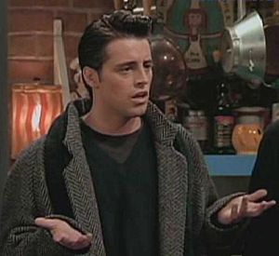
Tip Eight: Disposition
Be well-organized
Be nice
Notes:
Research on student evaluations of professors consistently find that students value two main characteristics: they expect the class to be well-organized, and they expect the teacher to be likeable. Well-organized jerks don’t do well, but neither do friendly dullards.

Slide 17
Tip Nine: Mentoring
Notes:
Ask a faculty member to be your “teaching mentor.” Obviously, you should pick someone who is a good teacher!
Your mentor should provide support and advise. (1) Have your mentor read through your course materials (syllabus, assignments, exams, etc.). (2) Ask your mentor to observe your teaching once or twice and provide feedback to you.

Slide 18
My Final Tip
Don’t Rely too heavily on Power Point Presentations
You really think that you are doing your students a favor by using Power Point presentations
You’re really not, because:
People end up reading the slides and not listening to you
And to make it worse, you put too much text on each slide, so they really don’t have the time or energy to focus on what you are presenting
And, besides – you, as an instructor become too dependent on them and just end up reading what’s on the slide. Which is really boring.
And you don’t make eye contact with the audience which simply BEGS them to zone out.
And you tempt your students to be lazy, because they know they can just look at these slides again when they need to study for the exam or write that big paper.

Slide 19
Recommended

